Slide 1
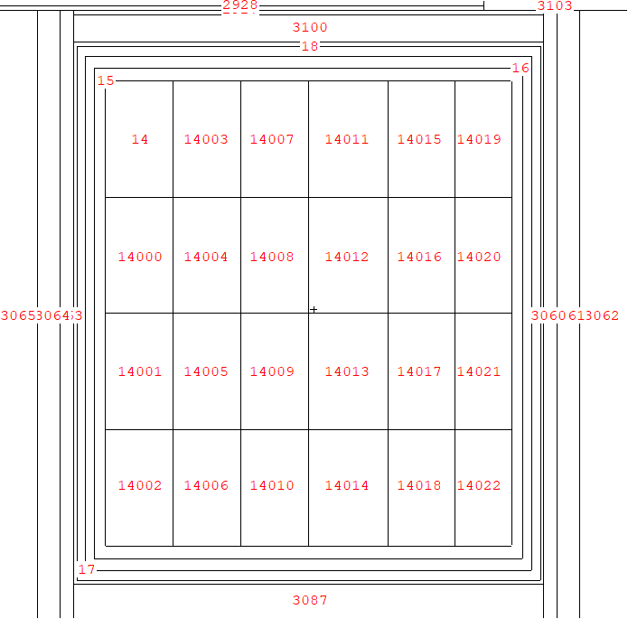
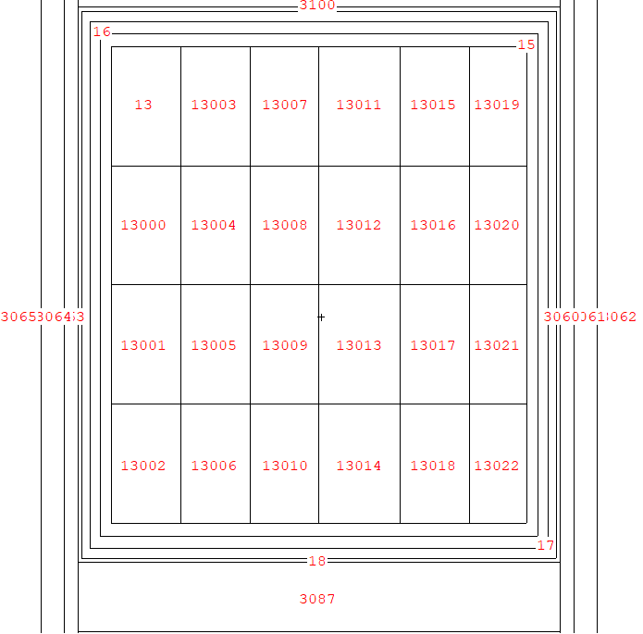
Cell numbering
Vertical cut through either side of poison foil

Slide 2
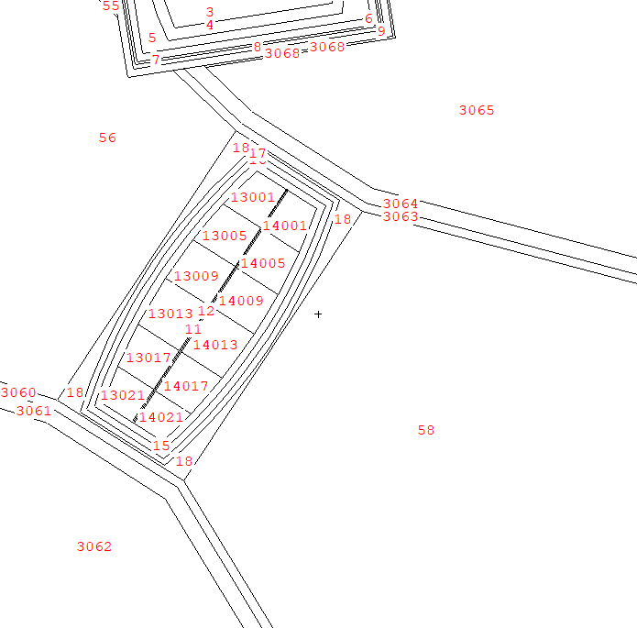
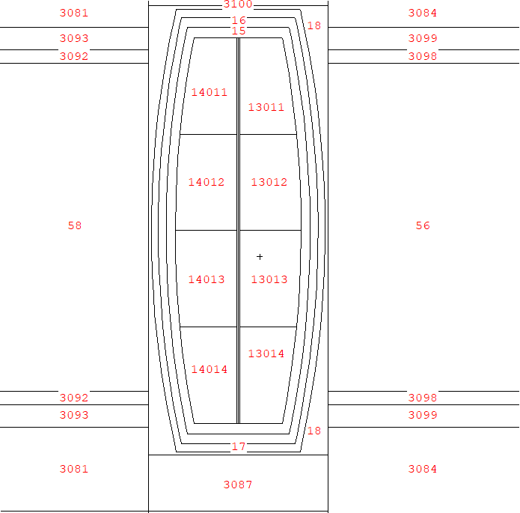
Cell numbering
Horizontal cut through centre
Vertical cut through centre

Slide 3
Cell numbers and corresponding dwell times estimate (s)
Based on the ¼ geometry diagram on the next slide
4.3
4.7
2.1
2.1
4.7
4.3
4.3
4.7
2.1
2.1
4.7
4.3
4.2
5.8
1.7
1.7
5.8
4.2
4.2
5.8
1.7
1.7
5.8
4.2
4.8
5.6
1.2
1.2
5.6
4.8
4.8
5.6
1.2
1.2
5.6
4.8
6.8
5.9
2.1
2.1
5.9
6.8
6.8
5.9
2.1
2.1
5.9
6.8

Slide 4
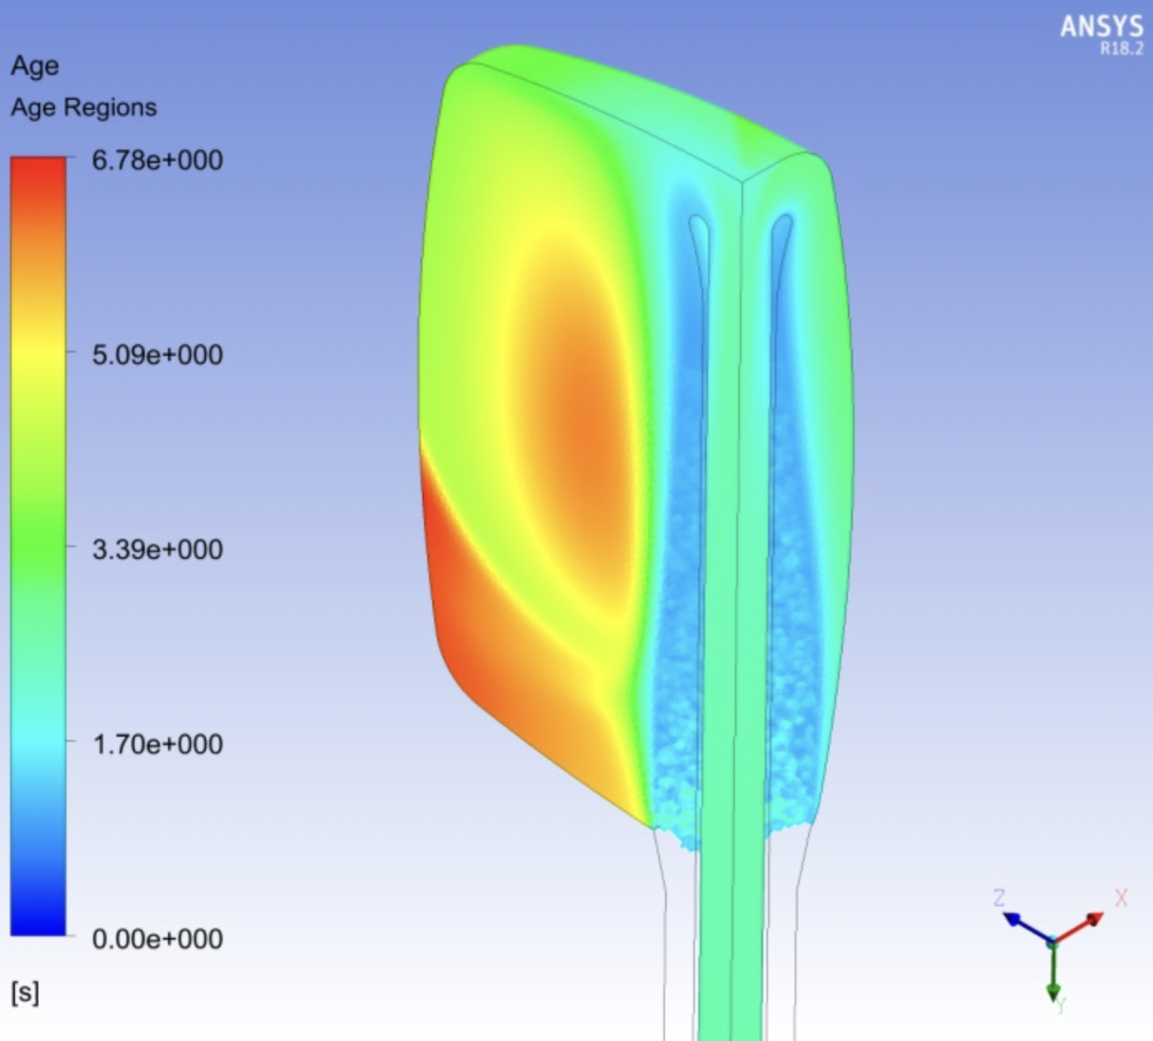
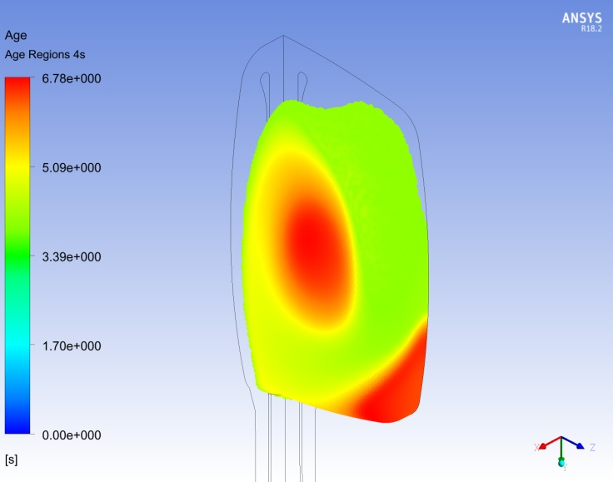
Dwell times diagrams
Taken from https://www.technologysi.stfc.ac.uk/Pages/ASD_HPT_ISIS-TS1.aspx
And powerpoint by Nathan O’Donoghue 2018
Figure 4. Reverse Fountain Isovolumes of Age > 4s - Back View

